Slide 1
Soaps and Detergents
Soaps and detergents are used
widely for cleaning purposes.
A soap or detergent is described as
a surfactant or ‘wetting’ agent. These
terms describe the behaviour of
substances which assist water to
remove grease, oil and other water
insoluble materials that adhere to surfaces.

Slide 2
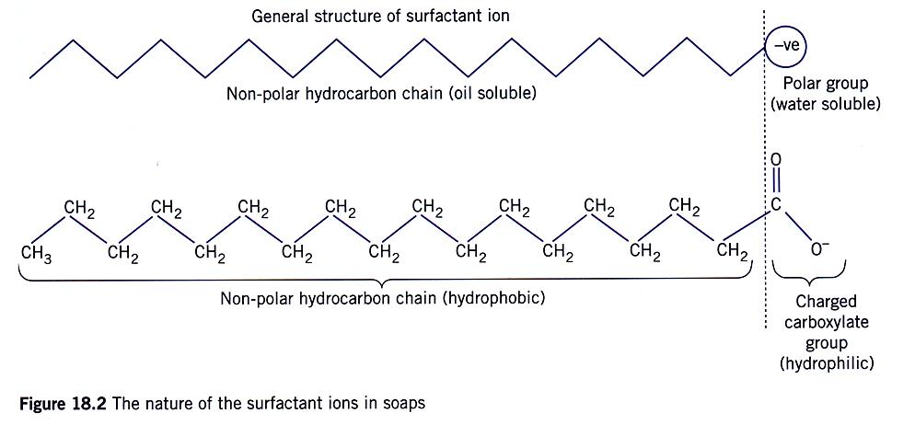
Structure of surfactant ions
Irwin, Farrelly, Vitlin, Garnett. Chemistry Contexts 2 (2nd Ed). Pearson 2006. Page 337.

Slide 3
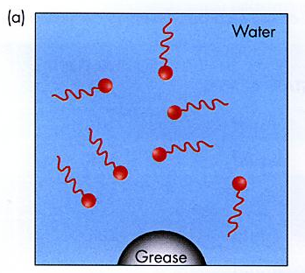
Surfactant ions dissolve in water.
James, Stokes, Ng, Moloney. Chemical Connections 2 (2nd Ed). Jacaranda 2000. Page 202.

Slide 4
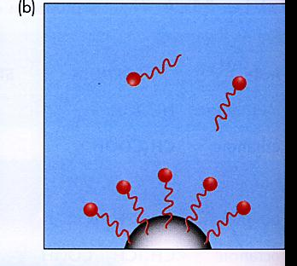
Non-polar tails are attracted to
non-polar grease particles.(dispersion)
James, Stokes, Ng, Moloney. Chemical Connections 2 (2nd Ed). Jacaranda 2000. Page 202.

Slide 5
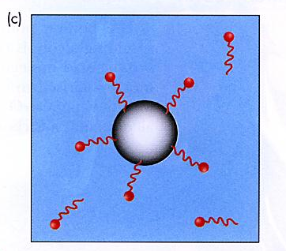
The polar head of the surfactant is
attracted to the water molecules and
the grease is lifted off the surface.
James, Stokes, Ng, Moloney. Chemical Connections 2 (2nd Ed). Jacaranda 2000. Page 202.

Slide 6
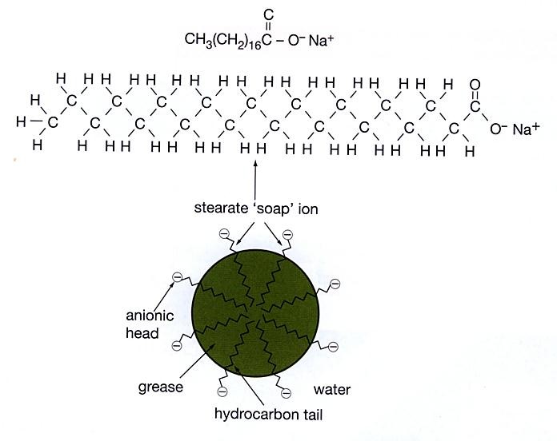
Hydrophobic
end
Hydrophilic
end
Smith, Monteath, Gould, Smith. Chemistry in Use Book 1. McGraw-Hill 2006. Page 65.

Slide 7
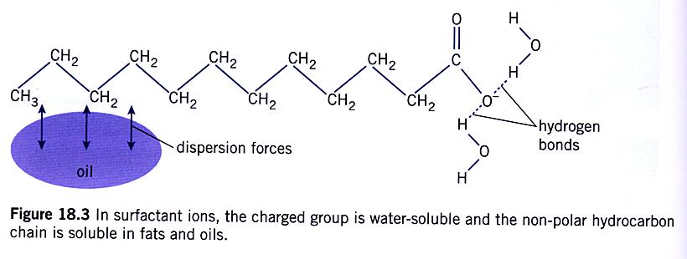
Note: H-bonding is attraction between lone pair of electrons
and appreciable positive charge on H that is directly bonded
to a N, O or F atom.
Irwin, Farrelly, Vitlin, Garnett. Chemistry Contexts 2 (2nd Ed). Pearson 2006. Page 338.

Slide 8
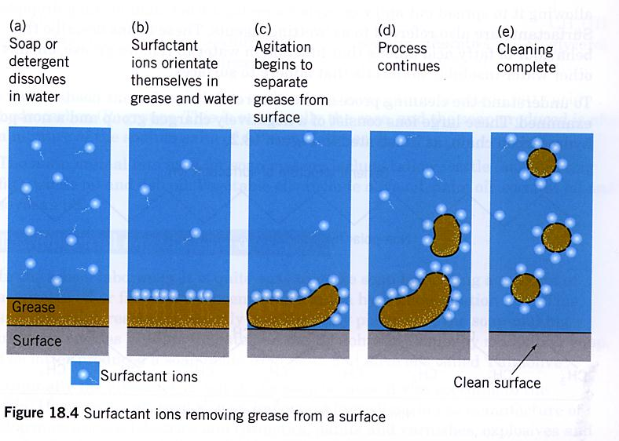
Some agitation is important
Irwin, Farrelly, Vitlin, Garnett. Chemistry Contexts 2 (2nd Ed). Pearson 2006. Page 338.

Slide 9
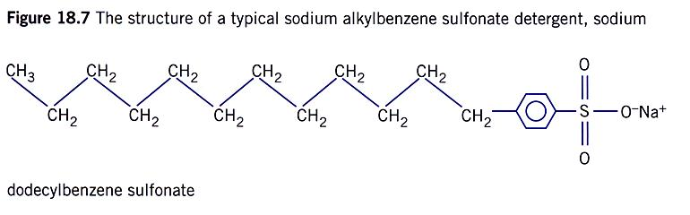
How are detergents different?
Still non-polar
tail
Still polar head
Irwin, Farrelly, Vitlin, Garnett. Chemistry Contexts 2 (2nd Ed). Pearson 2006. Page 341.

Slide 10
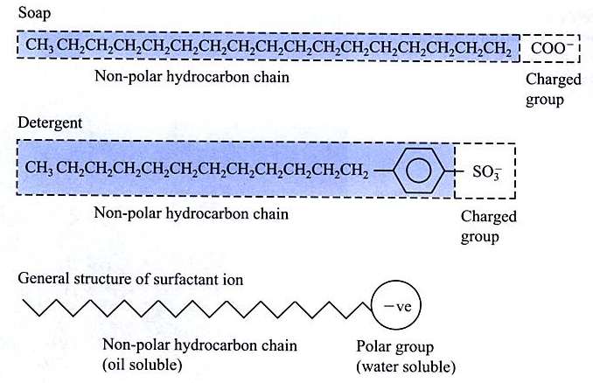
Compare soap and detergent structures
Ed P.J. Garnett. Foundations of Chemistry (2nd Ed). Longman 1996. Page 526.

Slide 11
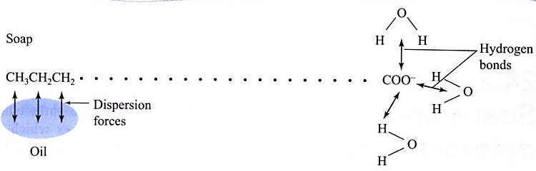
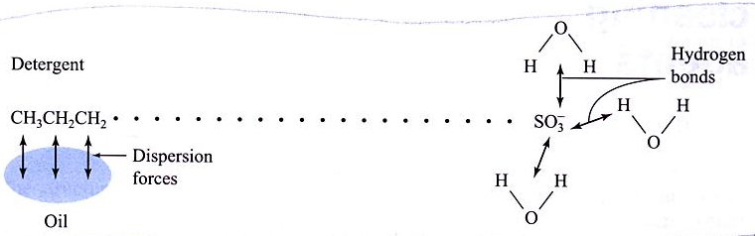
Compare action of soaps and detergents
Ed P.J. Garnett. Foundations of Chemistry (2nd Ed). Longman 1996. Page 526

Slide 12
Until the 1940’s soaps formed from the
hydrolysis of fats and oils were the main type
of cleaning agent used.
Problems associated with the use of soaps in
hard water (water containing calcium and
magnesium ions) sparked interest in
developing synthetic ‘soaps’. In the 1940’s a
group of substances called detergents were
produced for the first time.

Slide 13

Unlike the surfactant ions of soap the
alkylbenzene sulfonate ion does not
form a precipitate with calcium and
magnesium ions.
Equation for formation of ‘scum’ when soap
Surfactant ion reacts with hard water.
Surfactant ions derived from detergents
do not precipitate in this way.
Ed P.J. Garnett. Foundations of Chemistry (2nd Ed). Longman 1996. Page 527.

Slide 14
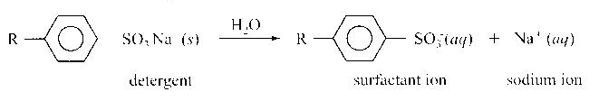
Detergent molecule dissolving in water
Ed P.J. Garnett. Foundations of Chemistry (2nd Ed). Longman 1996. Page 525.

Slide 15
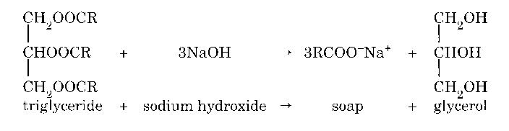
Preparation of Soap
Irwin, Farrelly, Vitlin, Garnett. Chemistry Contexts 2 (2nd Ed). Pearson 2006. Page 335.

Slide 16
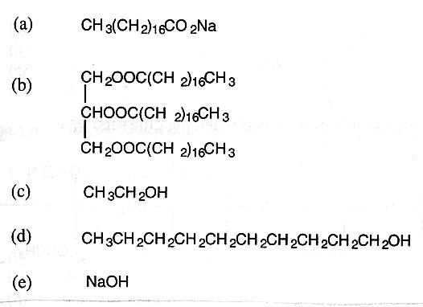
Test Yourself
1997 TEE
Which one of the following is a soap?
Answer: a

Slide 17
Syllabus requirements
Draw structural formulae to exemplify a
simple soap and a sulfonate detergent.
Describe the action of soaps and sulfonate
detergents in terms of the interaction of the
polar and non-polar parts on the molecule
with water and greases etc.
Describe the preparation of a simple soap
and write a simple equation for the reaction
(ester hydrolysis)

Slide 18
Prepare a simple soap and compare
the properties of soaps and sulfonate
detergents
Tyson 2006

